Slide 1

Academic Writing for Graduate Students
Week 2: An Approach to Academic Writing
Lecturer: Tiefu Zhang, Ph.D.

Slide 2

An Brief Introduction to Myself
Tiefu Zhang (Shaun), Ph.D.
TESOL – The University of Sydney

Slide 3

Introduction to Academic Writing for Graduate Students
1
The course is as much concerned with developing academic writers as it is with improving academic texts.
The course is conceived as providing assistance with writing part-genres (problem-solutions, methods, and discussions) and genres (book reviews and research papers).
2
3
It is targeted at graduate students across disciplines with limited experience writing academic English.
4
What you can learn from this course can help you write a good academic paper.

Slide 4
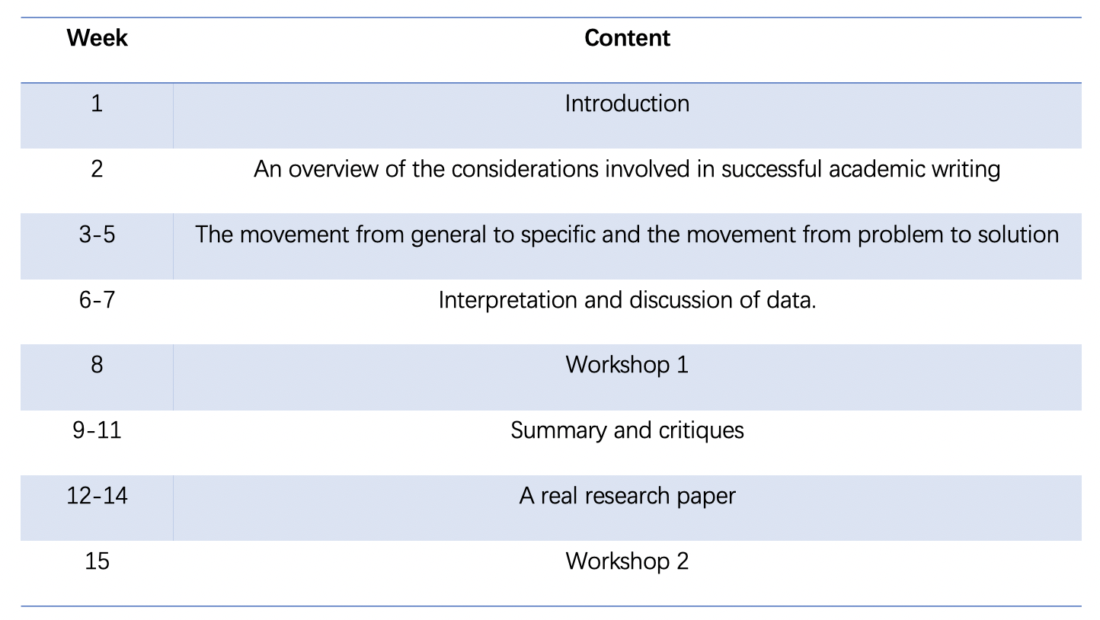
Course Structure

Slide 5
Assessment
Attendance 10%
Three assignments 60% (20% per each)
One research project 30%

Slide 6
Class Rules
Attend classes on time.
Don’t run.
Don’t leave rubbish.
Don’t sleep more than 5 minutes in the class.
Don’t play with your phone in the class.
Put up your hands before asking a question.
Plagiarism is not allowed.

Slide 7

What is academic writing?
A written product of many considerations: audience, tone, purpose, organisation, flow and presentation.
.

Slide 8
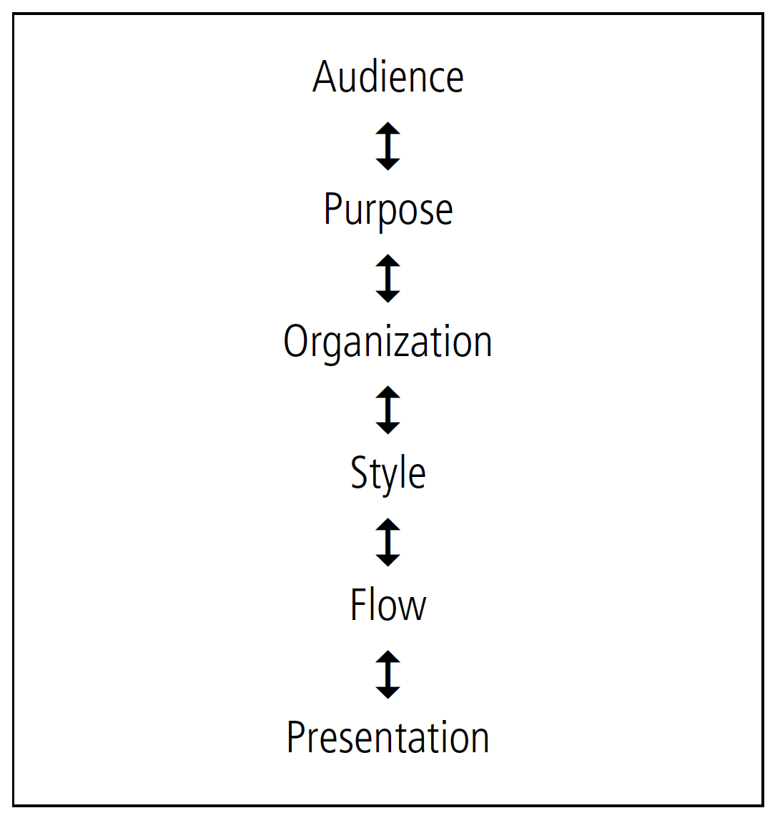
Considerations of Academic Writing

Slide 9
Task I
Discuss these possible writing strategies with a partner. Put a check mark (✓) next to those writing strategies that you use a lot. If you rarely or never use some of the strategies, discuss why you do not.

Slide 10
audience
Who is your audience?
  Your professors or instructors
Why do we need to know them?
  Help to communicate clearly and effectively
What do we need to do?
  Have an understanding of your expectations and prior knowledge

Slide 11
Task II
Now write a short definition of a term in your field for two different audiences. One audience could consist of graduate students in a totally unrelated field, while the other could be students in your own graduate program.
Exchange your definitions with a partner and discuss how they reflect differences in your chosen audiences.

Slide 12
tone
Tone is your style or manner of expression.
It depends on your subject manner and on your audience.
It is revealed by your texts.
Academic writing, it is formal and serious in tone

Slide 13
purpose
The main purpose of academic writing is to inform or persuade the audience
  Offers factual information
  Doesn’t intend to entertain
The purpose of a piece of writing determines the rhetorical form (organisation form and style) chosen for it.
  A persuasive essay and an argumentive essay are ogranised in different ways

Slide 14
ORGANISATION
Any information should be presented to readers in a
structured format. Even short piece of writing has
regular, predictable patterns of organization.

Slide 15
Task III
Read the good-news letter first, then read the bad-news letter, and label the four parts: greeting, preparation for bad news, bad news, and close. Where does the most important news appear (first? second?)? How does this compare to the good-news letter? How do the different purposes of the two letters influence the kind and placement of information?

Slide 16
Eight features of academic writing
Complexity 复杂度
Formality 正式
Explicitness 清楚明确
Precision 数据精准
Accuracy 用词准确
Hedging 模糊限制语
Objectivity 客观性
Responsibility 文责

Slide 17
complexity
More subordinate clauses and compound sentences.
It is clear that if learners fail to be provided with enough corrective feedback which draws their attention to their existing linguistic problems, fossilization is more likely to take place.
The first study involved a small-scale inquiry with 62 participants, while another study was carried out with 268 participants over six weeks with an additional delayed post-test session.

Slide 18
complexity
More passive verb constructions
Contrastive analysis was often used as a tool for teachers to treat student errors.
The reasoning is that when learners are challenged to construct a sentence they are forced to pay attention to form

Slide 19
complexity
Use nouns and noun-based phrases than verbs and verb-based phrases
There has been interest among researchers in understanding how L2 learners perceive the use of written corrective feedback and whether it has an impact on their writing performance.
There has been interest among researchers in understanding L2 learners’ perceptions of the use of written corrective feedback and its influence on their writing performance.

Slide 20
complexity
Use attributive adjectives.
It is hoped that this will influence future research design and that researchers will be more inclined to consider social, individual and contextual factors that may influence students’ feedback preferences, along with their retention and uptake of the feedback.

Slide 21
Formality
In an academic essay, we should avoid:
Colloquial words and expression: stuff, a lot of, thing, sort of
Abbreviated forms: can’t, etc., btw, doesn’t shouldn’t
Two word verbs : put off, bring up, take over
Asking questions

Slide 22
Task IV
Rewrite the following sentences, replacing the informal two-word verb with a more formal equivalent。

Slide 23
A primary education system was set up throughout Ireland as early as 1831.
This will cut down the amount of drug required and so the cost of treatment.
The material amenities of life have gone up in Western society.
The press reflected the living culture of the people; it could influence opinion and reinforce existing attitudes but it did not come up with new forms of entertainment.
Thus, the doctor should have looked into how the patient has coped previously.

Slide 24
Answer Key
A primary education system was established throughout Ireland as early as 1831.
This will reduce the amount of drug required and so the cost of treatment.
The material amenities of life have increased in Western society.
The press reflected the living culture of the people; it could influence opinion and reinforce existing attitudes but it did not create new forms of entertainment.
Thus, the doctor should have investigated how the patient has coped previously.

Slide 25
Hedging
In academic writing, you will often make claims or draw conclusions based on the evidence or data you are using to support your writing. However, despite the fact that this evidence may be strong, when you are writing in an academic style you have to use tentative language instead of assertive language.
Graduate students need more mental health support.
It seems that graduate students need more mental health support.

Slide 26
hedging
情态动词： must， would, may, might, could
频度副词：often， sometimes, usually, rarely
情态副词：certainly, definitely, probably, possibly, perhaps, likely
动词：seem, look like, tend to, suggest, presume, assume, indicate, reveal
名词：possibility, assumption, probability

Slide 27
hedging
It would seem that some researchers believe that occasionally some governments may deem taxes necessary.
Some taxes might be necessary for some governments.
    Research shows that export taxes are necessary for the Australian government.
It has been the case that taxes are necessary for governments.

Slide 28
Task V
Compare the following two texts and explain which you find more academic.
Text 1: Deb Roy’s 2011 Ted Talk “The Birth Of A Word”
Text 2: Deb Roy et al.’s (2009) study “Exploring Word Learning in a High-density Longitudinal Corpus

Slide 29
TEXT 1: This moment and thousands of other moments special for us were captured in our home because in every room in the house, if you looked up, you'd see a camera and a microphone, and if you looked down, you'd get this bird's-eye view of the room. Here's our living room, the baby bedroom, kitchen, dining room and the rest of the house. And all of these fed into a disc array that was designed for a continuous capture. So here we are flying through a day in our home as we move from sunlit morning through incandescent evening and, finally, lights out for the day. Over the course of three years, we recorded eight to 10 hours a day, amassing roughly a quarter-million hours of multi-track audio and video.
TEXT 2: The goal of HSP is to study early language development through analysis of audio and video recordings of the first two to three years of one child’s life. The home of the family of one of the authors (DR) with a newborn was outfitted with fourteen microphones and eleven omnidirectional cameras. Audio was recorded from ceiling mounted boundary layer microphones at 16 bit resolution with a sampling rate of 48 KHz. Due to the unique acoustic properties of boundary layer microphones, most speech throughout the house including very quiet speech was captured with sufficient clarity to enable reliable transcription. Video was also recorded to capture non-linguistic context using high resolution fisheye lens video cameras that provide a bird’s-eye view of people, objects, and activity throughout the home.

Slide 30
Homework
Find and download two journal articles from your field that you think are well written. Can you find examples that demonstrate how the authors dealt with the stylistic considerations as well as the possible need to be cautious? More importantly, can you offer explanations as to why certain stylistic choices were made and how these might relate to the author’s purpose? Use the chart on page 27 to guide your analysis.

Slide 31
Review
What have we learned today?

Slide 32
Thank you

